Slide 1
Università degli Studi di Milano
Master Degree in Computer Science
Information Management course
Teacher: Alberto Ceselli
Lecture 19: 18/12/2012

Slide 2
Data Mining:
Concepts and Techniques
(3rd ed.)
— Chapter 10 —
Jiawei Han, Micheline Kamber, and Jian Pei
University of Illinois at Urbana-Champaign &
Simon Fraser University
©2011 Han, Kamber & Pei. All rights reserved.
18
Notes:
18

Slide 3
Cluster Analysis: Concepts and Methods
Cluster Analysis: Basic Concepts
Partitioning Methods
Hierarchical Methods
Density-Based Methods
Grid-Based Methods
Evaluation of Clustering
Summary
18
18
Notes:
18

Slide 4
What is Cluster Analysis?
Cluster: A collection of data objects
  similar (or related) to one another within the same group
  dissimilar (or unrelated) to the objects in other groups
Cluster analysis (or clustering, data segmentation, …)
  Finding similarities between data according to the characteristics found in the data and grouping similar data objects into clusters
Unsupervised learning: no predefined classes (i.e., learning by observations vs. learning by examples: supervised)
Typical applications
  As a stand-alone tool to get insight into data distribution
  As a preprocessing step for other algorithms
18
Notes:
18

Slide 5
Applications of Cluster Analysis
Data reduction
  Summarization: Preprocessing for regression, PCA, classification, and association analysis
  Compression: Image processing: vector quantization
Hypothesis generation and testing
Prediction based on groups
  Cluster & find characteristics/patterns for each group
Finding K-nearest Neighbors
  Localizing search to one or a small number of clusters
Outlier detection: Outliers are often viewed as those “far away” from any cluster
18

Slide 6
Clustering: Application Examples
Biology: taxonomy of living things: kingdom, phylum, class, order, family, genus and species
Information retrieval: document clustering
Land use: Identification of areas of similar land use in an earth observation database
Marketing: Help marketers discover distinct groups in their customer bases, and then use this knowledge to develop targeted marketing programs
City-planning: Identifying groups of houses according to their house type, value, and geographical location
Earth-quake studies: Observed earth quake epicenters should be clustered along continent faults
Climate: understanding earth climate, find patterns of atmospheric and ocean
Economic Science: market research
18
Notes:
18

Slide 7
Basic Steps to Develop a Clustering Task
Feature selection
  Select info concerning the task of interest
  Minimal information redundancy
Proximity measure
  Similarity of two feature vectors
Clustering criterion
  Expressed via a cost function or some rules
Clustering algorithms
  Choice of algorithms
Validation of the results
  Validation test (also, clustering tendency test)
Interpretation of the results
  Integration with applications
18

Slide 8
Quality: What Is Good Clustering?
A good clustering method will produce high quality clusters
  high intra-class similarity: cohesive within clusters
  low inter-class similarity: distinctive between clusters
The quality of a clustering method depends on
  the similarity measure used by the method
  its implementation (optimality guarantees + computational effectiveness), and
  Its ability to discover some or all of the hidden patterns (practical behavior)
18
Notes:
18

Slide 9
Measure the Quality of Clustering
Dissimilarity/Similarity metric
  Similarity is expressed in terms of a pairwise distance function, typically metric: d(i, j)
  The definitions of distance functions are usually rather different for interval-scaled, boolean, categorical, ordinal ratio, and vector variables
  Weights should be associated with different variables based on applications and data semantics
Quality of clustering:
  There is usually a separate global quality function that measures the “goodness” of a cluster.
  It is hard to define “similar enough” or “good enough” (need to stick to the application!)
    The answer is typically highly subjective (i.e. don't blame the algorithm for modeling errors)
18
Notes:
18

Slide 10
Considerations for Cluster Analysis
Partitioning criteria
  Single level vs. hierarchical partitioning (often, multi-level hierarchical partitioning is desirable)
Separation of clusters
  Exclusive (e.g., one customer belongs to only one region) vs. non-exclusive (e.g., one document may belong to more than one class)
Similarity measure
  Distance-based (e.g., Euclidian, road network, vector) vs. connectivity-based (e.g., density or contiguity)
Clustering space
  Full space (often when low dimensional) vs. subspaces (often in high-dimensional clustering)
18

Slide 11
Requirements and Challenges
Scalability
  Clustering all the data instead of only on samples
Ability to deal with different types of attributes
  Numerical, binary, categorical, ordinal, linked, and mixture of these
Constraint-based clustering
    User may give inputs on constraints
    Use domain knowledge to determine input parameters
Interpretability and usability
Others
  Discovery of clusters with arbitrary shape
  Ability to deal with noisy data
  Incremental clustering and insensitivity to input order
  High dimensionality
18

Slide 12
Major Clustering Approaches
Partitioning approach:
  Construct various partitions and then evaluate them by some criterion, e.g., minimizing the sum of square errors
  Typical methods: k-means, k-medoids, CLARANS
Hierarchical approach:
  Create a hierarchical decomposition of the set of data (or objects) using some criterion
  Agglomerative (bottom-up) or divisive (top-down)
Density-based approach:
  Based on connectivity and density functions (keep growing as points are still in the neighborhood of cluster elements)
  Find arbitrarily shaped clusters
Grid-based approach:
  Quantize object space in a grid structure
  build a multiple-level granularity structure
18
Notes:
18

Slide 13
Major Clustering Approaches (II)
Model-based:
  A model is hypothesized for each of the clusters and tries to find the best fit of that model to each other
  Typical methods: EM, SOM, COBWEB
Frequent pattern-based:
  Based on the analysis of frequent patterns
  Typical methods: p-Cluster
User-guided or constraint-based:
  Clustering by considering user-specified or application-specific constraints
  Typical methods: COD (obstacles), constrained clustering
Link-based clustering:
  Objects are often linked together in various ways
  Massive links can be used to cluster objects: SimRank, LinkClus
18
Notes:
18

Slide 14
Cluster Analysis: Basic Concepts and Methods
Cluster Analysis: Basic Concepts
Partitioning Methods
Hierarchical Methods
Density-Based Methods
Grid-Based Methods
Evaluation of Clustering
Summary
18
18
Notes:
18

Slide 15
Partitioning Algorithms: Basic Concept
Partitioning method: Partitioning a database D of n objects into a set of k clusters, such that the sum of squared distances with respect to a cluster representative c_{i} is minimized (e.g. the centroid or medoid of cluster C_{i})
Given k, find a partition of k clusters that optimizes the chosen partitioning criterion
  Global optimal: exhaustively enumerate all partitions
  Heuristic methods: k-means and k-medoids algorithms
  k-means (MacQueen’67, Lloyd’57/’82): Each cluster is represented by the center of the cluster
  k-medoids or k-medians or PAM (Partition around medoids) (Kaufman & Rousseeuw’87): Each cluster is represented by one of the objects in the cluster
18
Notes:
18

Slide 16
The K-Means Clustering Method
Given k, the k-means algorithm is implemented in four steps:
  Partition objects into k nonempty subsets
  Compute seed points as the centroids of the clusters of the current partitioning (the centroid is the center, i.e., mean point, of the cluster)
  Assign each object to the cluster with the nearest seed point
  Go back to Step 2, stop when the assignment does not change
18
Notes:
18

Slide 17
An Example of K-Means Clustering
K=2
Arbitrarily partition objects into k groups
Update the cluster centroids
The initial data set
Loop if needed
Reassign objects
Partition objects into k nonempty subsets
Repeat
  Compute centroid (i.e., mean point) for each partition
  Assign each object to the cluster of its nearest centroid
Until no change
Update the cluster centroids
18
Notes:
18

Slide 18
Comments on the K-Means Method
Strength: Efficient: O(tkn), where n is # objects, k is # clusters, and t is # iterations. Normally, k, t << n.
    Comparing: PAM: O(k(n-k)² ), CLARA: O(ks² + k(n-k))
Comment: Often terminates at a local optimal
Weakness
  Applicable only to objects in a continuous n-dimensional space
    Using the k-modes method for categorical data
    In comparison, k-medoids can be applied to a wide range of data
  Need to specify k, the number of clusters, in advance (there are ways to automatically determine the best k (see Hastie et al., 2009)
  Sensitive to noisy data and outliers
  Not suitable to discover clusters with non-convex shapes
18
Notes:
18

Slide 19
Variations of the K-Means Method
Most of the variants of the k-means which differ in
  Selection of the initial k means
  Dissimilarity calculations
  Strategies to calculate cluster means
Handling categorical data: k-modes
  Replacing means of clusters with modes
  Using new dissimilarity measures to deal with categorical objects
  Using a frequency-based method to update modes of clusters
  A mixture of categorical and numerical data: k-prototype method
18
Notes:
18

Slide 20
What Is the Problem of the K-Means Method?
The k-means algorithm is sensitive to outliers !
  Since an object with an extremely large value may substantially distort the distribution of the data
K-Medoids: Instead of taking the mean value of the object in a cluster as a reference point, medoids can be used, which is the most centrally located object in a cluster
10
10
9
9
8
8
7
7
6
6
5
5
4
4
3
3
2
2
1
1
0
0
1
2
3
4
5
6
7
8
9
10
0
0
1
2
3
4
5
6
7
8
9
10
18
Notes:
18

Slide 21
PAM: A Typical K-Medoids Algorithm
Total Cost = 20
10
9
8
Arbitrary choose k object as initial medoids
Assign each remaining object to nearest medoids
7
6
5
4
3
2
1
0
0
1
2
3
4
5
6
7
8
9
10
K=2
Randomly select a nonmedoid object,O_{ramdom}
Total Cost = 26
Do loop
Until no change
10
10
9
Compute total cost of swapping
9
Swapping O and O_{ramdom}
If quality is improved.
8
8
7
7
6
6
5
5
4
4
3
3
2
2
1
1
0
0
1
2
3
4
5
6
7
8
9
10
0
0
1
2
3
4
5
6
7
8
9
10
18
Notes:
18

Slide 22
The K-Medoid Clustering Method
K-Medoids Clustering: Find representative objects (medoids) in clusters
  PAM (Partitioning Around Medoids, Kaufmann & Rousseeuw 1987)
    Starts from an initial set of medoids and iteratively replaces one of the medoids by one of the non-medoids if it improves the total distance of the resulting clustering
    PAM works effectively for small data sets, but does not scale well for large data sets (due to the computational complexity)
Efficiency improvement on PAM
  CLARA (Kaufmann & Rousseeuw, 1990): PAM on samples
  CLARANS (Ng & Han, 1994): Randomized re-sampling
18
Notes:
18

Slide 23
Chapter 10. Cluster Analysis: Basic Concepts and Methods
Cluster Analysis: Basic Concepts
Partitioning Methods
Hierarchical Methods
Density-Based Methods
Grid-Based Methods
Evaluation of Clustering
Summary
18
18
Notes:
18

Slide 24
Hierarchical Clustering
Use distance matrix as clustering criteria. This method does not require the number of clusters k as an input, but needs a termination condition
Step 0
Step 1
Step 2
Step 3
Step 4
agglomerative
(AGNES)
a
a b
b
a b c d e
c
c d e
d
d e
e
divisive
(DIANA)
Step 4
Step 3
Step 2
Step 1
Step 0
18
Notes:
18

Slide 25
AGNES (AGglomerative NESting)
Introduced in Kaufmann and Rousseeuw (1990)
Implemented in statistical packages, e.g., Splus
Use the single-link method and the dissimilarity matrix
Merge nodes that have the least dissimilarity
Go on in a non-descending fashion
Eventually all nodes belong to the same cluster
18
Notes:
18

Slide 26
Dendrogram: Shows How Clusters are Merged
  Decompose data objects into a several levels of nested partitioning (tree of clusters), called a dendrogram
  A clustering of the data objects is obtained by cutting the dendrogram at the desired level, then each connected component forms a cluster
18
Notes:
18

Slide 27
DIANA (DIvisive ANAlysis)
Introduced in Kaufmann and Rousseeuw (1990)
Implemented in statistical analysis packages, e.g., Splus
Inverse order of AGNES
Eventually each node forms a cluster on its own
18
Notes:
18

Slide 28
Distance between Clusters
X
X
Single link: smallest distance between an element in one cluster and an element in the other, i.e., dist(K_{i}, K_{j}) = min_{p in Ki, q in Kj} d(p,q)
Complete link: largest distance between an element in one cluster and an element in the other, i.e.,
dist(K_{i}, K_{j}) = max_{p in Ki, q in Kj} d(p,q)
Average: avg distance between an element in one cluster and an element in the other, i.e.,
dist(K_{i}, K_{j}) = sum_{p in Ki, q in Kj} d(p,q) / (|Ki||Kj|)
Centroid: distance between the centroids of two clusters, e.g.,
p = mean(Ki), q = mean(Kj), dist(K_{i}, K_{j}) = d(p,q)
Medoid: distance between the medoids of two clusters, i.e.,
p = median(Ki), q = median(Kj), dist(K_{i}, K_{j}) = d(p,q)
18
Notes:
18

Slide 29
Distance between Clusters
X
X
Algorithms using minimum distance are also called nearest-neighbor clustering algorithms
  they build minimum spanning trees
  if clustering is terminated when the minimum inter-cluster distance exceeds a given threshold they are called single-linkage
Algorithms using maximum distance are also called farthest-neighbor clustering algorithms
  If clustering is terminated when the maximum inter-cluster distance between nearest clusters exceeds a given threshold they are called complete-linkage
18
Notes:
18

Slide 30
Centroid, Radius and Diameter of a Cluster (for numerical data sets)
Centroid: the “middle” of a cluster
Radius: square root of average distance from any point of the cluster to its centroid
Diameter: square root of average mean squared distance between all pairs of points in the cluster
18
Notes:
18

Slide 31
Extensions to Hierarchical Clustering
Major weakness of agglomerative clustering methods
  Can never undo what was done previously
  Do not scale well: time complexity of at least O(n²), where n is the number of total objects
Integration of hierarchical & distance-based clustering
  BIRCH (1996): uses CF-tree and incrementally adjusts the quality of sub-clusters
  CHAMELEON (1999): hierarchical clustering using dynamic modeling
18
Notes:
18

Slide 32
BIRCH (Balanced Iterative Reducing and Clustering Using Hierarchies)
Zhang, Ramakrishnan & Livny, SIGMOD’96
Clustering Feature (CF): <n, LS, SS>
  n: number of points, LS: their sum, SS: their sum of squares
Easy to compute centroid, radius and diameter from CF
CFs are additive
Incrementally construct a CF tree, a hierarchical data structure for multiphase clustering
  Phase 1: scan DB to build an initial in-memory CF tree (a multi-level compression of the data that tries to preserve its inherent clustering structure)
  Phase 2: use an arbitrary clustering algorithm to cluster the leaf nodes of the CF-tree
18
Notes:
18

Slide 33
BIRCH (Balanced Iterative Reducing and Clustering Using Hierarchies)
Scales linearly: finds a good clustering with a single scan and improves the quality with a few additional scans
Weakness: handles only numeric data, and sensitive to the order of the data record
18
Notes:
18

Slide 34
Clustering Feature Vector in BIRCH
Clustering Feature (CF): CF = (N, LS, SS)
N: Number of data points
LS: linear sum of N points:
SS: square sum of N points
CF = (5, (16,30),(54,190))
(3,4)
(2,6)
(4,5)
(4,7)
(3,8)
18
Notes:
18

Slide 35

CF-Tree in BIRCH
Clustering feature:
  Summary of the statistics for a given subcluster: the 0-th, 1st, and 2nd moments of the subcluster from the statistical point of view
  Registers crucial measurements for computing cluster and utilizes storage efficiently
A CF tree is a height-balanced tree that stores the clustering features for a hierarchical clustering
  A nonleaf node in a tree has descendants or “children”
  The nonleaf nodes store sums of the CFs of their children
A CF tree has two parameters
  Branching factor: max # of children
  Threshold: max diameter of sub-clusters stored at the leaf nodes
18
Notes:
18

Slide 36
The CF Tree Structure
Root
B = 7
L = 6
CF₁
CF₂
CF₃
CF₆
child₁
child₂
child₃
child₆
Non-leaf node
CF₁
CF₂
CF₃
CF₅
child₁
child₂
child₃
child₅
Leaf node
Leaf node
prev
CF₁
CF₂
CF₆
next
prev
CF₁
CF₂
CF₄
next
18
Notes:
18

Slide 37
The Birch Algorithm
Cluster Diameter
For each point in the input
  Find closest leaf entry
  Add point to leaf entry and update CF
  If entry diameter > max_diameter, then split leaf, and possibly parents
Algorithm is O(n)
Concerns
  Sensitive to insertion order of data points
  Since we fix the size of leaf nodes, so clusters may not be so natural
  Clusters tend to be spherical given the radius and diameter measures
18
Notes:
18

Slide 38
CHAMELEON: Hierarchical Clustering Using Dynamic Modeling (1999)
CHAMELEON: G. Karypis, E. H. Han, and V. Kumar, 1999
Measures the similarity based on a dynamic model
  Two clusters are merged only if the interconnectivity and closeness (proximity) between two clusters are high relative to the internal interconnectivity of the clusters and closeness of items within the clusters
Graph-based, and a two-phase algorithm
  Use a graph-partitioning algorithm: cluster objects into a large number of relatively small sub-clusters
  Use an agglomerative hierarchical clustering algorithm: find the genuine clusters by repeatedly combining these sub-clusters
18
Notes:
18

Slide 39
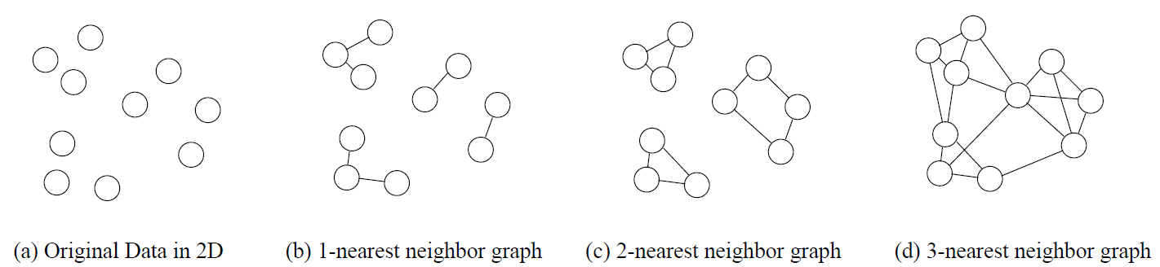
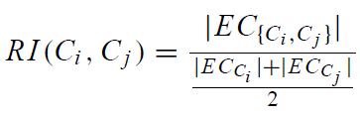
KNN Graphs & Interconnectivity
k-nearest graphs from an original data in 2D:
EC_{{Ci ,Cj } :}The absolute inter-connectivity between C_{i} and C_{j}: the sum of the weight of the edges that connect vertices in C_{i} to vertices in C_{j}
Internal inter-connectivity of a cluster C_{i} : the size of its min-cut bisector EC_{Ci} (i.e., the weighted sum of edges that partition the graph into two roughly equal parts)
Relative Inter-connectivity (RI):
18

Slide 40
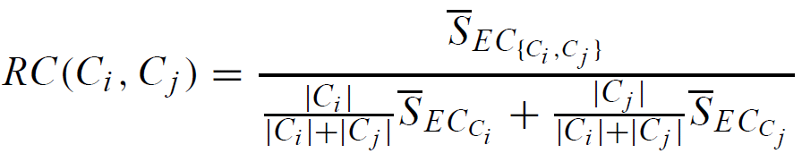



Relative Closeness & Merge of Sub-Clusters
Relative closeness between a pair of clusters C_{i} and C_{j} : the absolute closeness between C_{i} and C_{j} normalized w.r.t. the internal closeness of the two clusters C_{i} and C_{j}
  and are the average weights of the edges that belong in the min-cut bisector of clusters C_{i} and C_{j} , respectively, and is the average weight of the edges that connect vertices in C_{i} to vertices in C_{j}
Merge Sub-Clusters:
  Merges only those pairs of clusters whose RI and RC are both above some user-specified thresholds
  Merge those maximizing a function combining RI & RC
18

Slide 41
Overall Framework of CHAMELEON
Construct (K-NN)
Sparse Graph
Partition the Graph
Data Set
K-NN Graph
  P and q are connected if q is among the top k closest neighbors of p
Merge Partition
Relative interconnectivity: connectivity of c₁ and c₂ over internal connectivity
Relative closeness: closeness of c₁ and c₂ over internal closeness
Final Clusters
18
Notes:
18

Slide 42
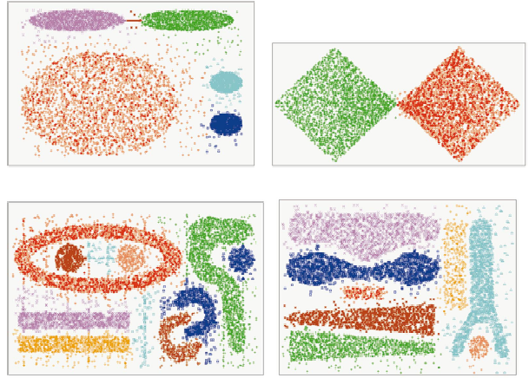
CHAMELEON (Clustering Complex Objects)
18
Notes:
18

Slide 43
Probabilistic Hierarchical Clustering
Algorithmic hierarchical clustering
  Nontrivial to choose a good distance measure
  Hard to handle missing attribute values
  No optimality guarantees: heuristic, local search
Probabilistic hierarchical clustering
  Use probabilistic models to measure distances between clusters
  Generative model: Regard the set of data objects to be clustered as a sample of the underlying data generation mechanism to be analyzed
  Easy to understand, same efficiency as algorithmic agglomerative clustering method, can handle partially observed data
In practice, assume the generative models adopt common distributions functions, e.g., Gaussian distribution or Bernoulli distribution, governed by parameters
18

Slide 44

Generative Model
Given a set of 1-D points X = {x₁, …, x_{n}} for clustering analysis & assuming they are generated by a Gaussian distribution:
The probability that a point x_{i} ∈ X is generated by the model
The likelihood that X is generated by the model:
The task of learning the generative model: find the parameters μ and σ² such that
the maximum likelihood
18

Slide 45
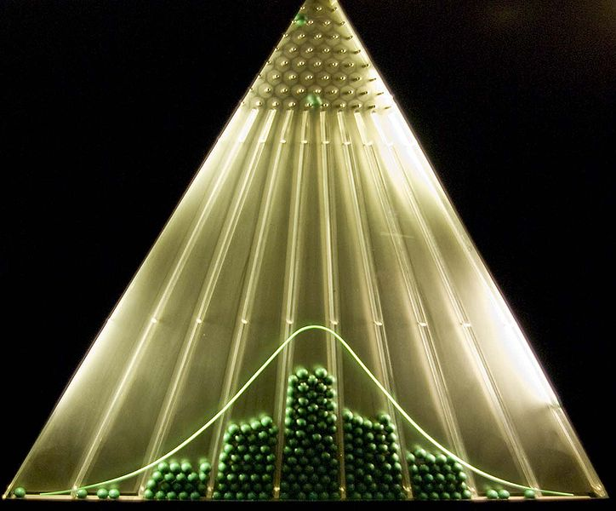
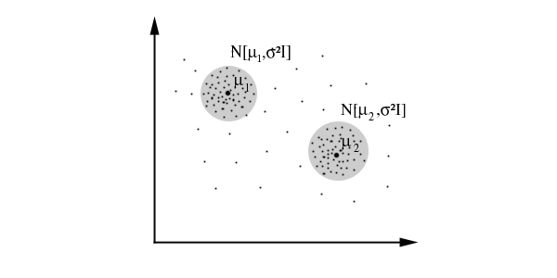
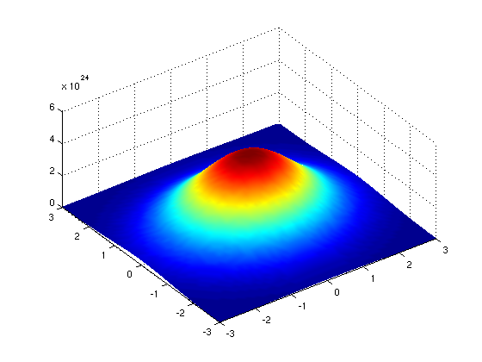
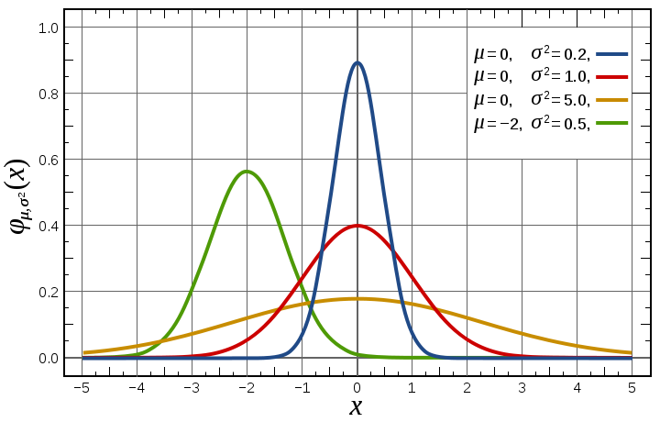
Gaussian Distribution
Bean machine: drop ball with pins
1-d Gaussian
2-d Gaussian
From wikipedia and http://home.dei.polimi.it
18

Slide 46

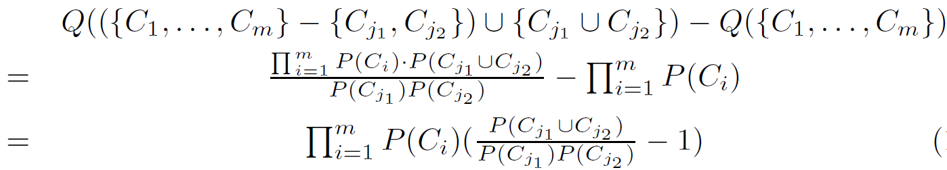
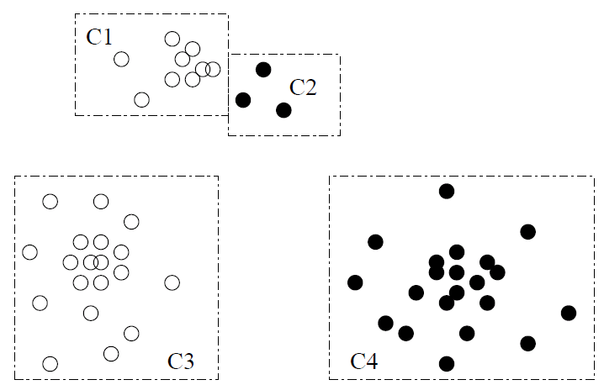

A Probabilistic Hierarchical Clustering Algorithm
For a set of objects partitioned into m clusters C₁, . . . ,C_{m}, the quality can be measured by,
  where P() is the maximum likelihood
If we merge two clusters C_{j1} and C_{j2} into a cluster C_{j1}∪C_{j2}, then, the change in quality of the overall clustering is
Distance between clusters C₁ and C₂:
18

Slide 47
Cluster Analysis: Basic Concepts and Methods
Cluster Analysis: Basic Concepts
Partitioning Methods
Hierarchical Methods
Density-Based Methods
Grid-Based Methods
Evaluation of Clustering
Summary
18
18
Notes:
18

Slide 48
Density-Based Clustering Methods
Clustering based on density (local cluster criterion), such as density-connected points
Major features:
  Discover clusters of arbitrary shape
  Handle noise
  One scan
  Need density parameters as termination condition
Several interesting studies:
  DBSCAN: Ester, et al. (KDD’96)
  OPTICS: Ankerst, et al (SIGMOD’99).
  DENCLUE: Hinneburg & D. Keim (KDD’98)
  CLIQUE: Agrawal, et al. (SIGMOD’98) (more grid-based)
18
Notes:
18

Slide 49
Density-Based Clustering: Basic Concepts
Two parameters:
  Eps: Maximum radius of the neighbourhood
  MinPts: Minimum number of points in an Eps-neighbourhood of that point
N_{Eps}(q): {p belongs to D | dist(p,q) ≤ Eps}
Directly density-reachable: A point p is directly density-reachable from a point q w.r.t. Eps, MinPts if
  p belongs to N_{Eps}(q)
  core point condition:
  |N_{Eps} (q)| ≥ MinPts
p
MinPts = 5
Eps = 1 cm
q
18
Notes:
18

Slide 50
Density-Reachable and Density-Connected
Density-reachable:
  A point p is density-reachable from a point q w.r.t. Eps, MinPts if there is a chain of points p₁, …, p_{n}, p₁ = q, p_{n} = p such that p_{i+1} is directly density-reachable from p_{i}
Density-connected
  A point p is density-connected to a point q w.r.t. Eps, MinPts if there is a point o such that both, p and q are density-reachable from o w.r.t. Eps and MinPts
p
p₁
q
p
q
o
18
Notes:
18

Slide 51
DBSCAN: Density-Based Spatial Clustering of Applications with Noise
Relies on a density-based notion of cluster: A cluster is defined as a maximal set of density-connected points
Discovers clusters of arbitrary shape in spatial databases with noise
Outlier
Border
Eps = 1cm
MinPts = 5
Core
18
Notes:
18

Slide 52
DBSCAN: The Algorithm
Arbitrary select a point p
Retrieve all points density-reachable from p w.r.t. Eps and MinPts
If p is a core point, a cluster is formed
If p is a border point, no points are density-reachable from p and DBSCAN visits the next point of the database
Continue the process until all of the points have been processed
If a spatial index is used, the computational complexity of DBSCAN is O(nlogn), where n is the number of database objects. Otherwise, the complexity is O(n²)
18
Notes:
18

Slide 53
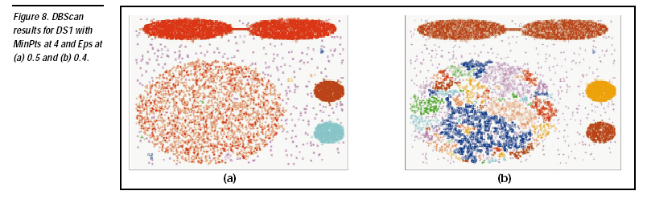

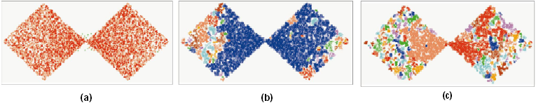
DBSCAN: Sensitive to Parameters
DBSCAN online Demo:
http://webdocs.cs.ualberta.ca/~yaling/Cluster/Applet/Code/Cluster.html
18
Notes:
18

Slide 54
OPTICS: A Cluster-Ordering Method (1999)
OPTICS: Ordering Points To Identify the Clustering Structure
  Ankerst, Breunig, Kriegel, and Sander (SIGMOD’99)
  Produces a special order of the database wrt its density-based clustering structure
  This cluster-ordering contains info equiv to the density-based clusterings corresponding to a broad range of parameter settings
  Good for both automatic and interactive cluster analysis, including finding intrinsic clustering structure
  Can be represented graphically or using visualization techniques
18
Notes:
18

Slide 55
OPTICS: Some Extension from DBSCAN
Index-based: k = # of dimensions, N: # of points
  Complexity: O(N*logN)
Core Distance of an object p: the smallest value ε such that the ε-neighborhood of p has at least MinPts objects
  Let N_{ε}(p): ε-neighborhood of p, ε is a distance value
  Core-distance_{ε, MinPts}(p) = Undefined if card(N_{ε}(p)) < MinPts
      MinPts-distance(p), otherwise
Reachability Distance of object p from core object q is the min radius value that makes p density-reachable from q
    Reachability-distance_{ε, MinPts}(p, q) =
      Undefined if q is not a core object
      max(core-distance(q), distance (q, p)), otherwise
18
Notes:
18

Slide 56
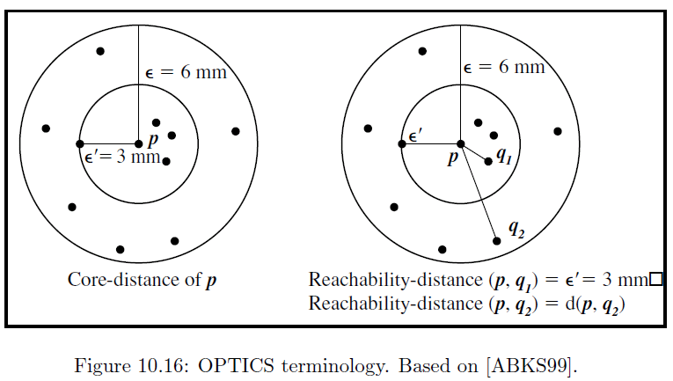
Core Distance & Reachability Distance
18

Slide 57
Reachability-distance
undefined
‘
Cluster-order of the objects
18
Notes:
18

Slide 58
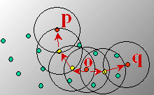
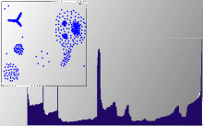
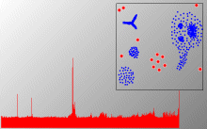
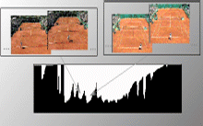
Density-Based Clustering: OPTICS & Applications demo: http://www.dbs.informatik.uni-muenchen.de/Forschung/KDD/Clustering/OPTICS/Demo
18
Notes:
18

Slide 59
DENCLUE: Using Statistical Density Functions
DENsity-based CLUstEring by Hinneburg & Keim (KDD’98)
Using statistical density functions:
Major features
  Uses gaussian kernel density approximation
  Clusters can be determined mathematically by identifying density attractors (local maxima of the overall density function)
  Center defined clusters: assign to each density attractor the points density attracted to it (pick each point and follow the gradient)
total influence on x
influence of y on x
gradient of x in the direction of x_{i}
18
Notes:
18

Slide 60
Denclue: Technical Essence
Arbitrary shaped cluster: merge density attractors that are connected through paths of high density (> threshold)
Solid mathematical foundation
Good for data sets with large amounts of noise
Allows a compact mathematical description of arbitrarily shaped clusters in high-dimensional data sets
Significant faster than existing algorithm (e.g., DBSCAN)
But needs a large number of parameters
18
Notes:
18

Slide 61
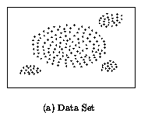
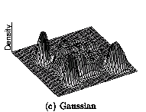
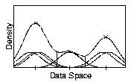
Density Attractor
18
Notes:
18

Slide 62
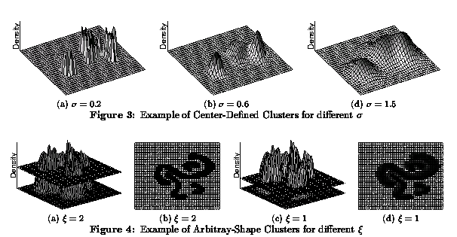
Center-Defined and Arbitrary
18
Notes:
18

Slide 63
Chapter 10. Cluster Analysis: Basic Concepts and Methods
Cluster Analysis: Basic Concepts
Partitioning Methods
Hierarchical Methods
Density-Based Methods
Grid-Based Methods
Evaluation of Clustering
Summary
18
18
Notes:
18

Slide 64
Grid-Based Clustering Method
Using multi-resolution grid data structure
Several interesting methods
  STING (a STatistical INformation Grid approach) by Wang, Yang and Muntz (1997)
  WaveCluster by Sheikholeslami, Chatterjee, and Zhang (VLDB’98)
    A multi-resolution clustering approach using wavelet method
  CLIQUE: Agrawal, et al. (SIGMOD’98)
    Both grid-based and subspace clustering
18
Notes:
18

Slide 65
STING: A Statistical Information Grid Approach
Wang, Yang and Muntz (VLDB’97)
The spatial area is divided into rectangular cells
There are several levels of cells corresponding to different levels of resolution
18
Notes:
18

Slide 66
The STING Clustering Method
Each cell at a high level is partitioned into a number of smaller cells in the next lower level
Statistical info of each cell is calculated and stored beforehand and is used to answer queries
Parameters of higher level cells can be easily calculated from parameters of lower level cell
  count, mean, s, min, max
  type of distribution—normal, uniform, etc.
Use a top-down approach to answer spatial data queries
Start from a pre-selected layer—typically with a small number of cells
For each cell in the current level compute the confidence interval
18
Notes:
18

Slide 67
STING Algorithm and Its Analysis
Remove the irrelevant cells from further consideration
When finish examining the current layer, proceed to the next lower level
Repeat this process until the bottom layer is reached
Advantages:
  Query-independent, easy to parallelize, incremental update
  O(K), where K is the number of grid cells at the lowest level
Disadvantages:
  All the cluster boundaries are either horizontal or vertical, and no diagonal boundary is detected
18
Notes:
18

Slide 68
CLIQUE (Clustering In QUEst)
Agrawal, Gehrke, Gunopulos, Raghavan (SIGMOD’98)
Automatically identifying subspaces of a high dimensional data space that allow better clustering than original space
CLIQUE can be considered as both density-based and grid-based
  It partitions each dimension into the same number of equal length interval
  It partitions an m-dimensional data space into non-overlapping rectangular units
  A unit is dense if the fraction of total data points contained in the unit exceeds the input model parameter
  A cluster is a maximal set of connected dense units within a subspace
18
Notes:
18

Slide 69
CLIQUE: The Major Steps
Partition the data space and find the number of points that lie inside each cell of the partition.
Identify the subspaces that contain clusters using the Apriori principle
Identify clusters
  Determine dense units in all subspaces of interests
  Determine connected dense units in all subspaces of interests.
Generate minimal description for the clusters
  Determine maximal regions that cover a cluster of connected dense units for each cluster
  Determination of minimal cover for each cluster
18
Notes:
18

Slide 70
Salary (10,000)
Vacation(week)
7
7
6
6
5
5
4
4
3
3
2
2
1
1
0
age
0
age
20
30
40
50
60
20
30
40
50
60
τ = 3
Vacation
Salary
30
50
age
18
Notes:
18

Slide 71
Strength and Weakness of CLIQUE
Strength
  automatically finds subspaces of the highest dimensionality such that high density clusters exist in those subspaces
  insensitive to the order of records in input and does not presume some canonical data distribution
  scales linearly with the size of input and has good scalability as the number of dimensions in the data increases
Weakness
  The accuracy of the clustering result may be degraded at the expense of simplicity of the method
18
Notes:
18

